Slide 1
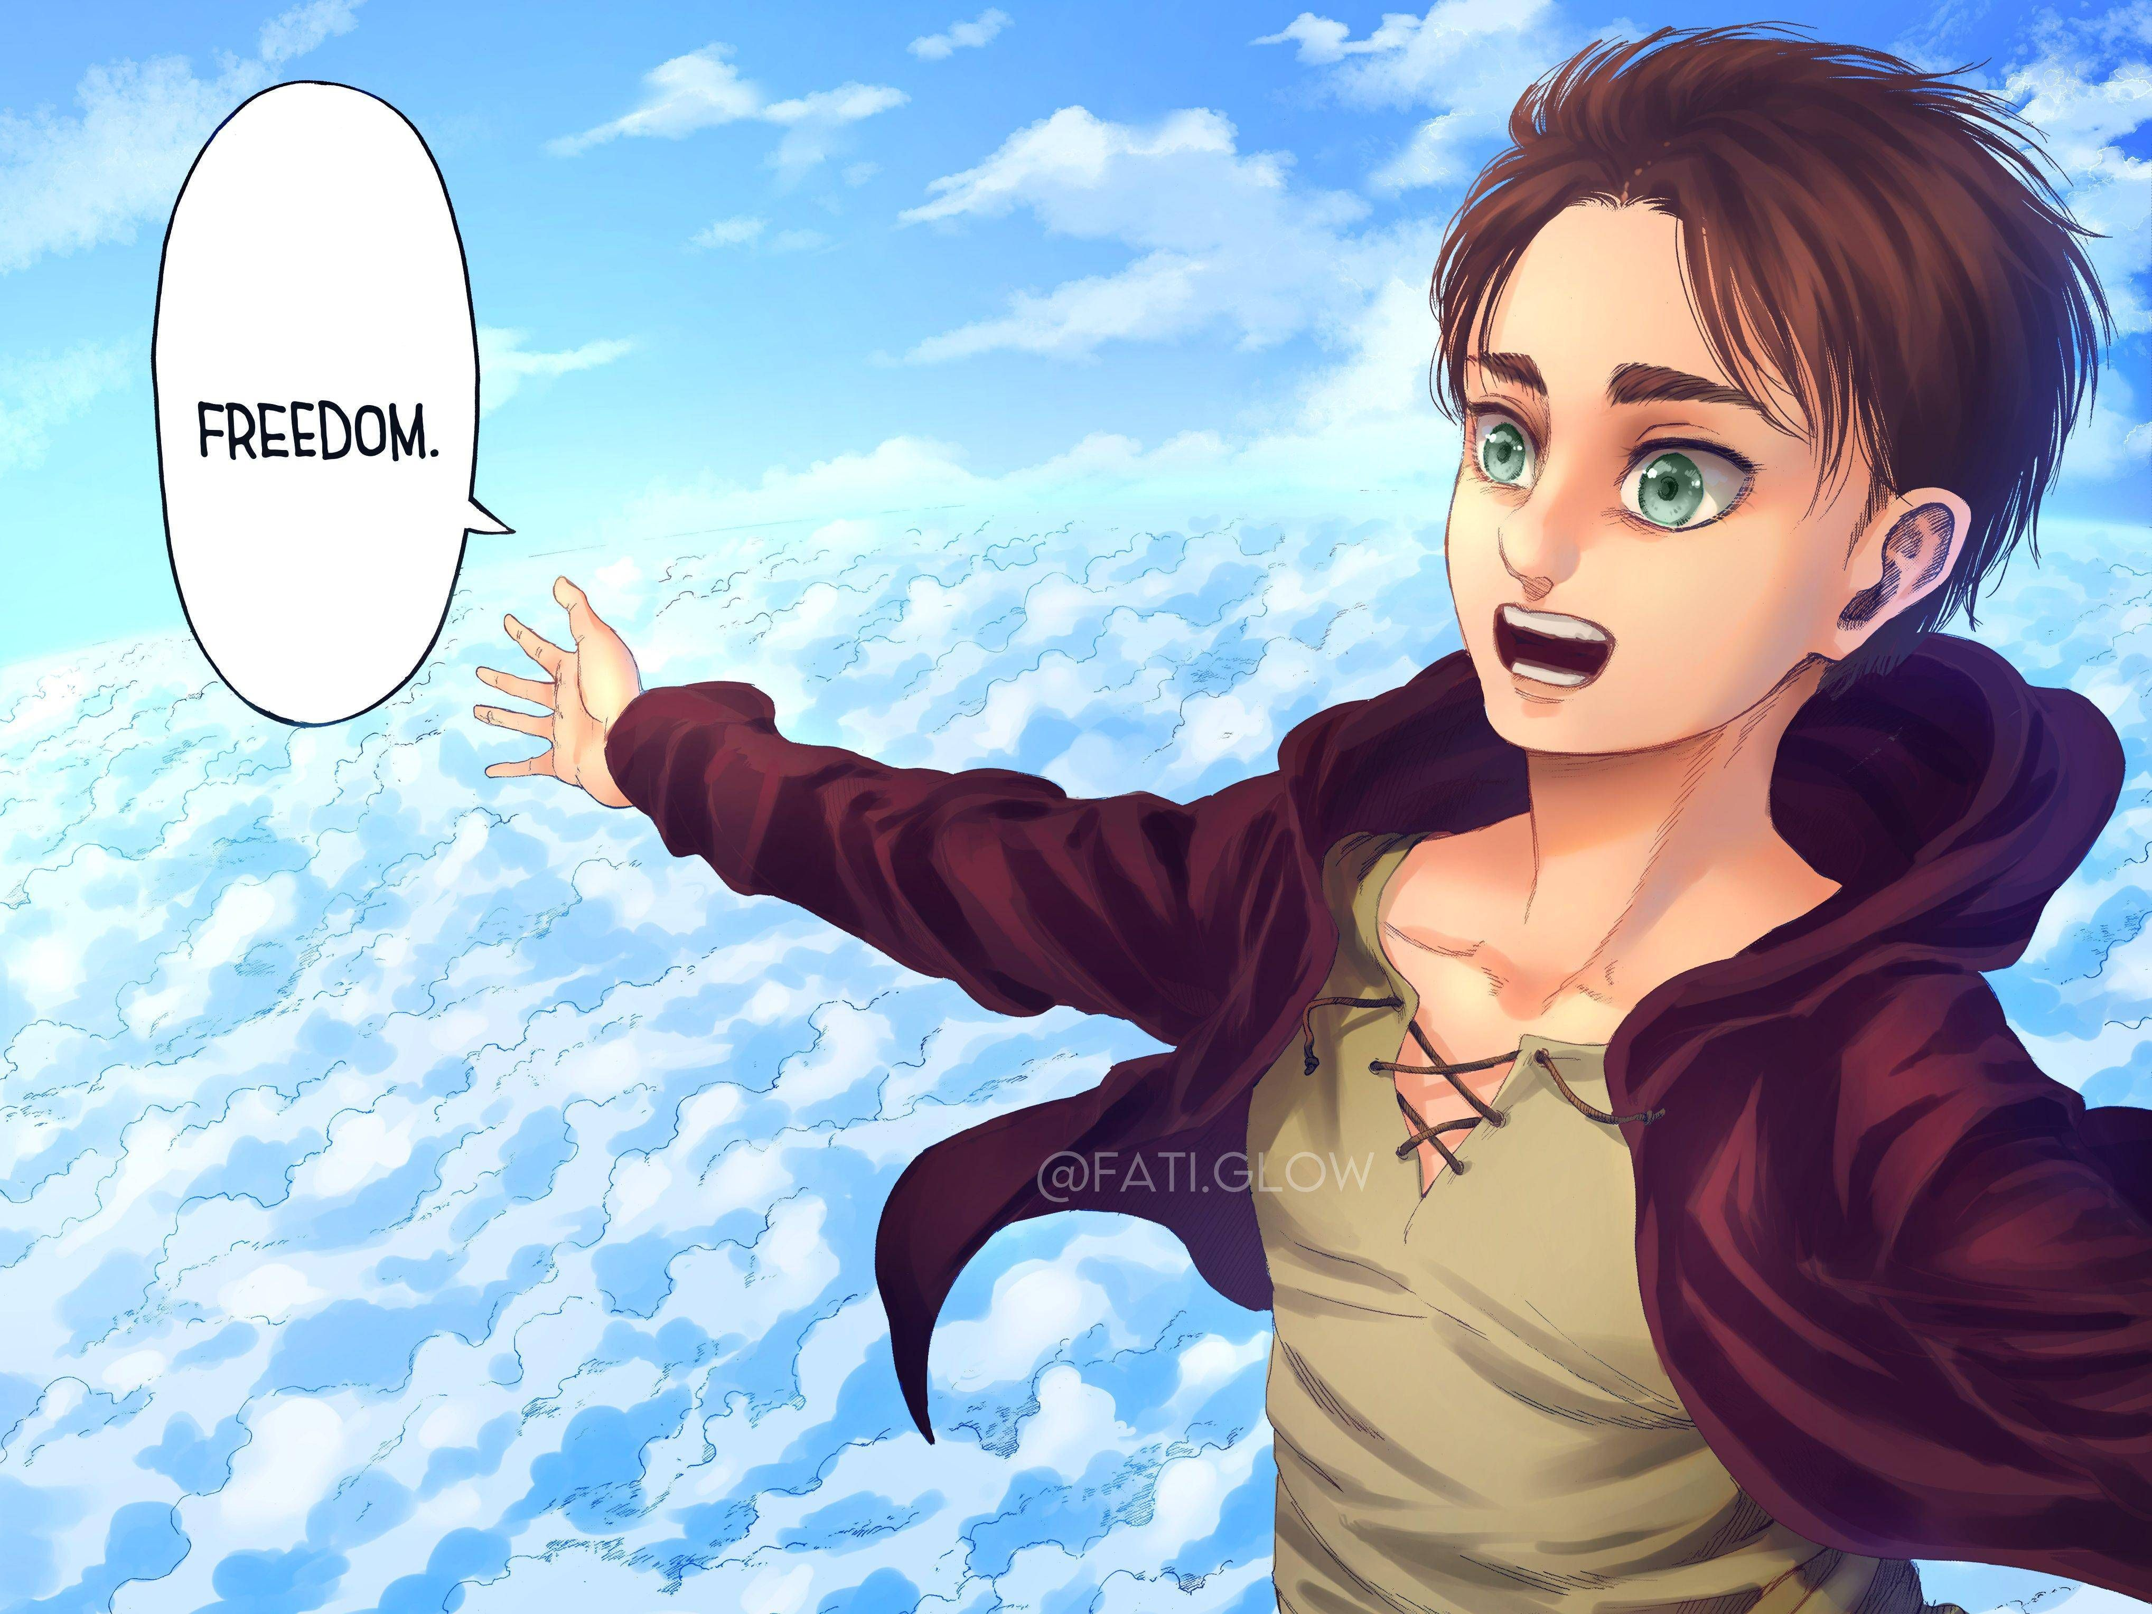
ARDUINO CODING PROJECT
BY WILLIAM SOPER, MONTY VILLEGAS VERSCHOYLE, DANIEL ARANDA, DARNELL FORD

Slide 2

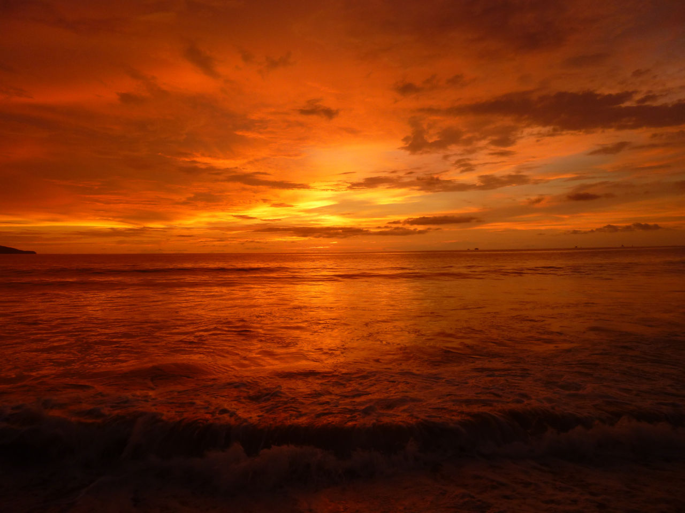
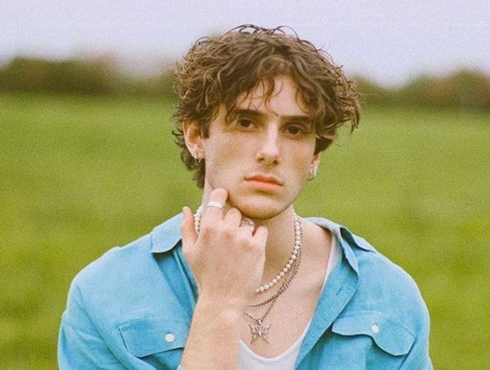
SONG CHOICE

Slide 3

Song Background
JVKE wrote and produced the song with his brother

Slide 4
The Code

Slide 5


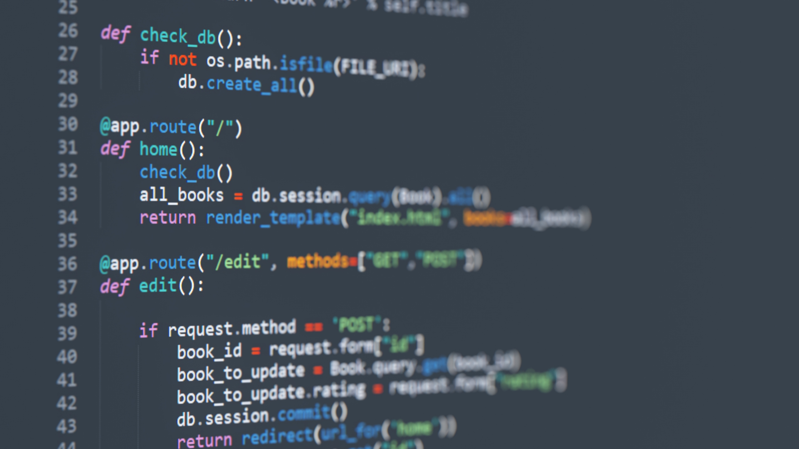
Roles
Monty Villegas Verschoyle: Main code builder, Presentation editor, Quartermaster
William Soper: Presentation builder, Translator, Presentation editor
Darnell Ford: Translator, Presentation builder, Code editor
Daniel Aranda: Presentation builder, Rehearsal, Translator

Slide 6
Variables

Slide 7
Tones & Frequencies

